Slide 1

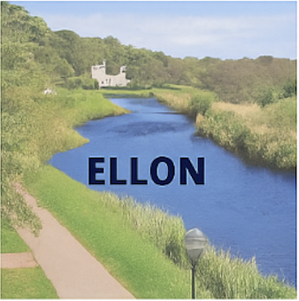




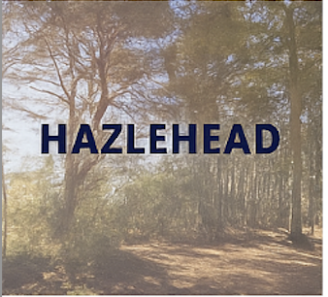

Slide 2
Blackburn Youth 2018 Scavenger Hunt –
50 Things to Find Over Summer
☐ A yellow flower ☐ A piece of metal
☐ A thistle ☐ A dog on a lead
☐ A dandelion puffball ☐ Someone wearing red
☐ A pine cone ☐ Someone wearing a hat
☐ A feather ☐ 5 pieces of rubbish (put in the bin for extra feel good factor)
☐ A butterfly ☐ A smile from a stranger
☐ A squirrel ☐ A puddle to jump in
☐ A bird in flight ☐ A signpost
☐ A dolphin ☐ A painted rock
☐ A spider web ☐ A bug under a log
☐ A crab ☐ A tree with bark peeling off
☐ A mushroom ☐ A fallen branch
☐ A stick shaped like a letter ☐ A pair of sunglasses
☐ A tree stump ☐ A iron bru bottle
☐ A rock bigger than your hand ☐ A back to front baseball hat
☐ A smooth pebble ☐ A leaf with holes in it
☐ A puddle ☐ A jogger with headphones
☐ A leaf bigger than your face ☐ A daisy chain (created by you – over 18 daisies long)
☐ A tree with twisted branches ☐ A bin with a lid
☐ A patch of moss ☐ A group selfie being taken
☐ A wooden bench ☐ A family running together
☐ A bridge ☐ A running buggy
☐ A squirrel's nest (drey) ☐ A pair of colourful socks
☐ A snail ☐ A dog bowl
☐ A caterpillar ☐ A pair of pink sunglasses

